Slide 1
Research Methodology- Unit 5 DATA COLLECTION AND ANALYSIS
Prime College- BIM 6th Semester

Slide 2
Research Methodology- Unit 5 Chapter 5- Quantitative Data Analysis Methods
Prime College- BIM 6th Semester

Slide 3


Learning Outcome 1
Quantitative Data Analysis Methods
Concepts
Data Organizing and Preparing
Graphic and Diagrammatic Presentation

Slide 4
Quantitative Data Analysis Methods
Data analysis is a process of getting meaningful interpretations from the collected data to reach the ultimate conclusion of research work.
Data analysis consists of the computation of certain measures, searching relationships among data–groups, interpretation of findings, and making conclusions.
Data analysis consists of:
a. Data organizing
b. Data preparation
c. Data presenting
d. Data interpretation

Slide 5
Data Organizing
Data organizing is classifying and organizing data sets to make them more meaningful and usable.
This is the primary function after data collection and consists of classification and physical records so that it can be retained and understood quickly whenever needed.
Data is required at different times of study and analysis. Among large data, quick access is impossible. Thus, choosing a logical and consistent name for the data file is necessary.
Data files must be prepared according to the subject matter of data so that they can be easily accessible.
The following things help to develop such a system:
 Use folders
 Name folders appropriately
 Be consistent
 Separate ongoing and completed work
 Move the files to an external drive
 Make backup files
 Review records:

Slide 6

Data Preparing

Slide 7
Data Preparing
1. Data Editing
Raw data must be processed by editing it.
It ensures that the data provided are accurate, complete, and consistent.
It is a process of checking the completeness and consistency of data. This process helps to prepare the data for coding.
It can be performed manually, with the assistance of computer programming, or a combination of both. It depends on the medium (electronic, paper) by which the data are submitted.
Levels of Editing
Micro–editing: It corrects the data at the record level. This process detects errors in data through checks of the individual data records. The intent at this point is to determine the consistency of the data and correct the individual data records.
2. Macro–editing: It also detects errors in data but does this through the analysis of aggregate data but not one-to-one. In such editing, data are compared with data from other resources like surveys, administrative
files, baseline studies, or earlier versions of the same data. This process determines the compatibility of data
Objectives of data editing
 To determine whether or not the data are complete
 To ensure the accuracy of data
 To confirm the consistency of the data
 To ensure the rationality of aggregated data
 To obtain the best possible data available

Slide 8
Data Preparing
1. Data Editing
Types of data editing
Validity edits: look at one question field or cell at a time. They check to ensure the record identifiers, invalid characters, and values have been accounted for; essential fields have been completed (no quantity field is left blank where a number is required); specified units of measure have been appropriately used; and the reported within specified time limits
Range edits: are similar to validity edits in looking at one field at a time. This type of edit ensures that the values, ratios, and calculations fall within the established limits
Duplication edits: examine one full record at a time. These edits check for duplicated records, ensuring that a respondent or a survey item has only been recorded once.
Consistency edits: For example, if a person is declared to be in the 0 to 14 age group but also claims that he or she is retired, there is a consistency problem between the two answers.
Historical edits: editors compare survey answers in current and previous surveys. For example, any dramatic changes since the last survey will be flagged.
Statistical edits: editors look at the entire data set. This type of edit is performed only after all other edits have been applied and the data have been corrected.

Slide 9
Data Preparing
2. Data Coding
Data coding is a process of data processing used for converting the responses recorded in the questionnaire into categories usually expressed numerically.
Coding is a technical procedure for converting verbal information into numbers or other symbols, which can be used more.
Coding consists of a series of technical procedures that aims to convert verbal responses into numerals or accepted forms of symbols.
This helps to make it easier for rapid and flexible storage, retrieval, and tabulation
Principles of data coding
 Coding must resolve ambiguity so that the codes can be applied consistently.
 Symbols and numerals used in coding must be defined clearly and well accepted.
 Develop a coding system as much as possible when designing that data collection instrument.
 Develop a code book to facilitate and well-record the coding system

Slide 10
Data Preparing
3. Classification of data
Data classification is the process of categorizing data for its most effective and efficient use.
Data collected by various methods are enormous, voluminous, and unorganized.
Makes it valid, readable, comparable, and easy to handle, data should be classified into various groups and subgroups
Classification is done in terms of:
 Essential similarities and dissimilarities in the data
 Clusters of related factors can be observed repeatedly with consistent regularity and
 Recurring sequences of events
Objectives of classification
 To simplify the voluminous facts in a more straightforward, understandable, and meaningful form.
 To facilitate comparison of variables.
 To enable the use of statistical tests of significance.
 To facilitate the basis of tabulation.
 To arrange data as per similarities and dissimilarities.

Slide 11
Data Preparing
3. Classification of data
Types of classification
Geographical classification
Chronological classification
Qualitative classification
Qualitative classification
Quantitative classification

Slide 12
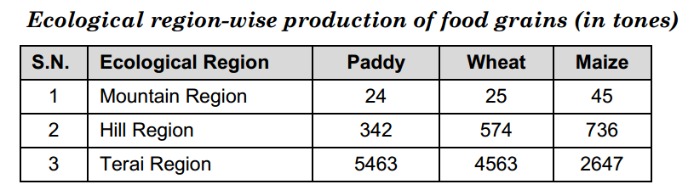
Data Preparing
3. Classification of data
Types of classification
Geographical classification:
This type of classification is made based on geographical or location or spatial differences between various variables or respondents or study units like cities, districts, ecological regions, etc.,

Slide 13
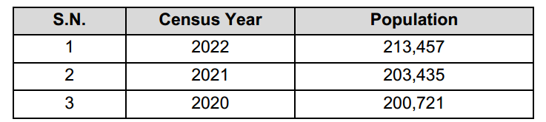
Data Preparing
3. Classification of data
Types of classification
ii. Chronological classification:
If the data are collected over a period of time, chronological classification is used.
It is a time series classification, e.g., fiscal year, census year, academic year, or any time interval for major shift in practices or policies.
Number of students enrolled in TU in different years is given in following table:

Slide 14
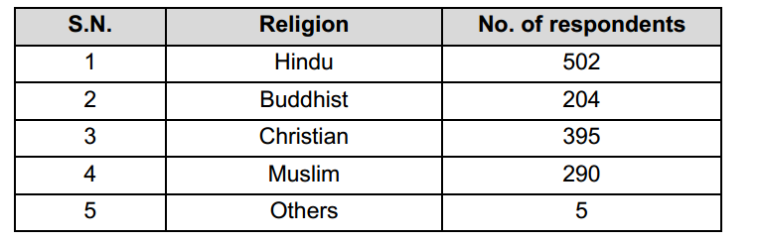
Data Preparing
3. Classification of data
Types of classification
iii. Qualitative classification:
In this type of classification, data are classified based on some attribute (note that the attribute under study cannot be measured) or quality, such as sex, religion, literacy, academic qualification, managerial position, etc.
For example, respondents’ classification based on religion is presented below:

Slide 15
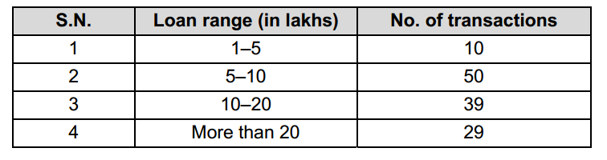
Data Preparing
3. Classification of data
Types of classification
iv. Quantitative classification:
Is based on quantitatively measurable characteristics.
For example, a researcher can classify organizations based on annual net income, production capacity, revenue generation, paid-up capital, tax paid, number of employees, number of products or service offerings, etc.
For example, the number of loan transactions in a bank in a month is classified as follows:

Slide 16
Data Preparing
3. Tabulation of data
Tabulation of data is the last step of the data processing and pre–analysis process.
The art of presenting facts in an understandable form attracts the readers.
Tabulation is a systematic arrangement of data in a matrix form, i.e., arranging into rows and columns in order.
Objectives of tabulation
 To facilitate comparison between two or more series
 To measure the variables statistically and interpretation
 To help in easy understanding of data
 To save time and effort in interpretation and understanding
 To ensure there is no repetition of data entry

Slide 17
Data Preparing
3. Tabulation of data
Parts of a table
Table number
Title
Caption: It is the title of the column or column heading and describes what the column represents
Stub: It is the title of the row or row heading. Stubs are placed at the extreme left. Male, female, and total written in the following table indicating the basis of classification is the stub.
Body of the table
Head note
Footnote
Source

Slide 18
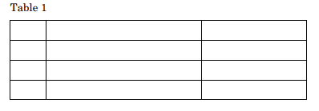
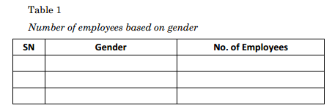
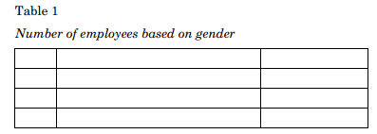
Data Preparing
3. Tabulation of data
Parts of a table
Table number
2. Title
3. Caption

Slide 19
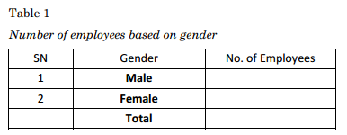
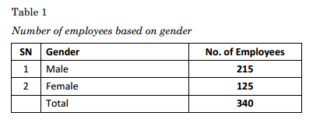
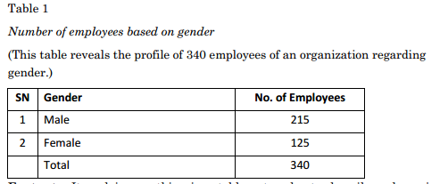
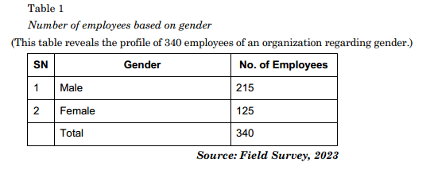
Data Preparing
3. Tabulation of data
Parts of a table
4. Stub
5. Body of the table
6. Head note
9. Source

Slide 20
Data Preparing
3. Tabulation of data
Tabular structure
Tabular structure is a way of presenting processed data into rows and columns.
Different structures are used to describe or present the data regarding several variables.
Univariate tabular structure
Bivariate tabular structure
Multivariate Tabular Structure (More than two interrelated variables described)

Slide 21
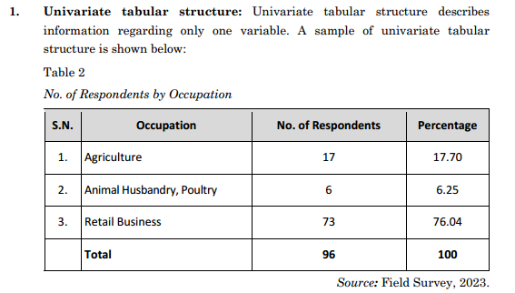
Data Preparing
3. Tabulation of data
Tabular structure

Slide 22
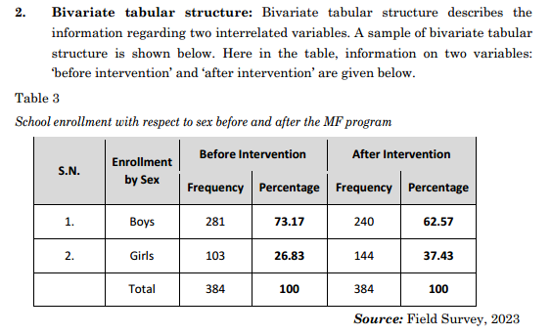
Data Preparing
3. Tabulation of data
Tabular structure

Slide 23
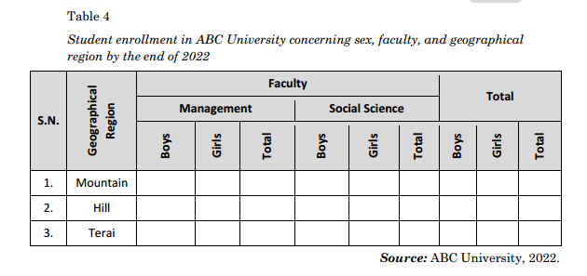
Data Preparing
3. Tabulation of data
Tabular structure
Multivariate Tabular Structure (More than two interrelated variables described): Multivariate tabular structure describes the information regarding two or more variables. A sample of a multivariate tabular structure is shown below. Here in the table, information regarding ‘geographical region,’ ‘sex,’ ‘management stream,’ and ‘social science stream’ is presented.

Slide 24
Data Preparing
3. Tabulation of data
Graphic & Diagrammatic Presentation
Graphs and charts are ways of presenting data in diagrammatic and pictorial structures.
Processed data illustrated in graphic and diagrammatic structures, i.e., graphs and charts are easily readable, visible, understandable, and comparable.
Importance of Diagrams and Charts
Diagrams and charts are helpful for the following reasons:
 It provides a bird's eye view of the data in few words and figures. The information sought from the data is easily understood. In this context, there is a famous saying that a picture is worth 10,000 words that comes to true.
 Diagrams and graphs seem attractive to the eye, so they can quickly grasp the
reader's attraction.
 It helps to make quick and accurate comparisons.
 It creates an excellent memorizing effect.

Slide 25
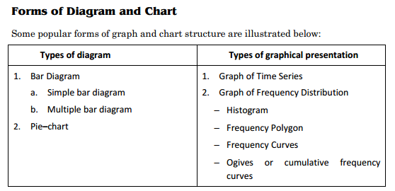
Data Preparing
3. Tabulation of data
Forms of Diagram and Chart

Slide 26
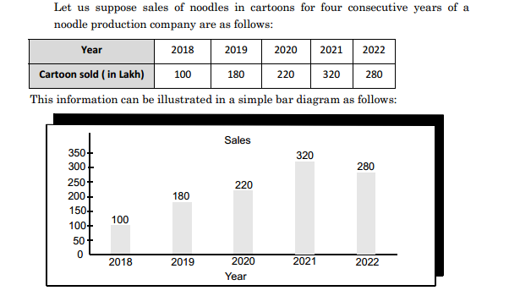
Data Preparing
3. Tabulation of data: Graphical Representation
Forms of Diagram and Chart: Types of Diagram
i. Bar diagram: A bar diagram is the most popular and straightforward diagram used in data presentation. In the bar diagram, the bar representing the information of each variable is drawn with a standard width. A bar graph can a simple or multiple-bar diagram based on several variables used in the bar.
a. Simple bar graph:
A simple bar graph helps present a single variable with its respective values. It is simple to prepare and understand. A simple bar graph gives only a single information at a time hence, many graphs need to be
prepared to show the total information.

Slide 27
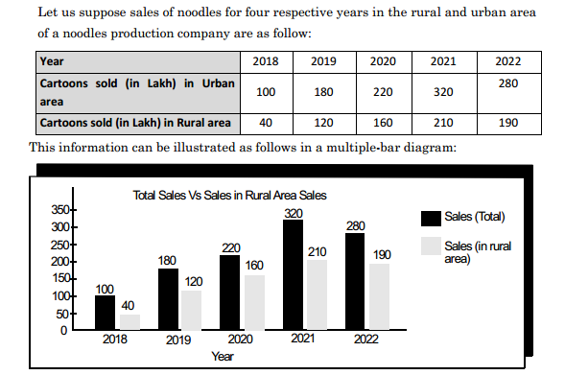
Data Preparing
3. Tabulation of data: Graphical Representation
Forms of Diagram and Chart: Types of Diagram
i. Bar diagram: A bar diagram is the most popular and straightforward diagram used in data presentation. In the bar diagram, the bar representing the information of each variable is drawn with a standard width. A bar graph can a simple or multiple-bar diagram based on several variables used in the bar.
b. Multiple bar diagram:
A multiple bar diagram is the same as a simple bar
diagram, but two or more variables can be presented in easily comparable form. The reader can easily compare the variables as different variables with their respective information are presented in a diagram. It saves time and effort for both the researcher and the reader. Multiple bar diagrams are more attractive in comparison to simple bar diagrams.

Slide 28
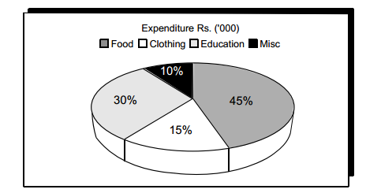
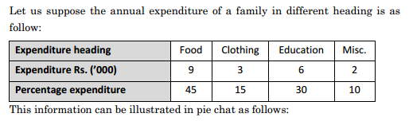
Data Preparing
3. Tabulation of data: Graphical Representation
Forms of Diagram and Chart: Types of Diagram
Pie chart: In practice, pie charts are popularly used to show the percentage contributions or composition of each item or variable out of the total. This is the angular representation that each variable’s contribution is converted into a part of 360o or percentage. It is called a pie chart because the entire graph looks like a pie, and the individual components resemble slices cut from the pie.

Slide 29
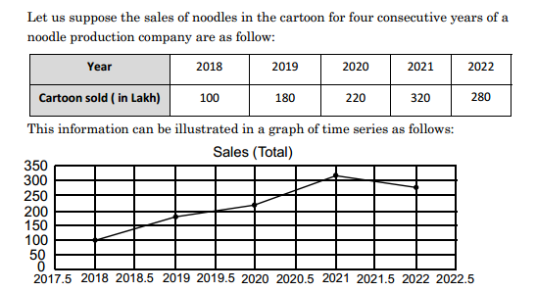
Data Preparing
3. Tabulation of data: Graphical Representation
Forms of Diagram and Chart: Types of Graphical Presentation
i. Graph of time series: When we observe the values of variables at different points of time, then the series so formed is known as time series. Information collected at different points or time intervals can be expressed in a graphical structure to reflect the change in magnitude or to observe the trend.

Slide 30
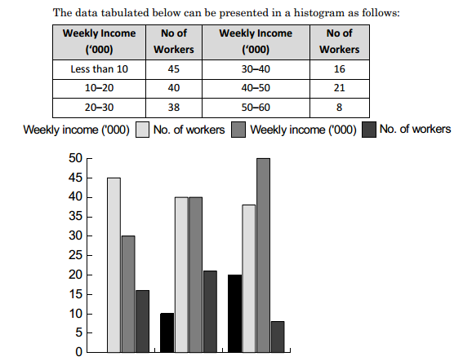
Data Preparing
3. Tabulation of data: Graphical Representation
Forms of Diagram and Chart: Types of Graphical Presentation
ii. Histogram: Among various methods of graphical presentation of frequency distribution, histogram is one of the popular methods and widely used in practice. A histogram is a bar chart or graphical presentation showing the frequency of occurrence of each variable's value being analyzed. A histogram is quite different from a bar diagram because a bar diagram is one-dimensional, which means only the bar's length is considered

Slide 31
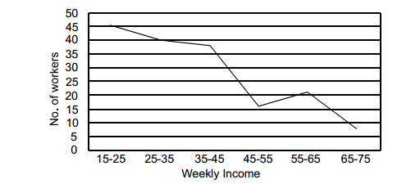
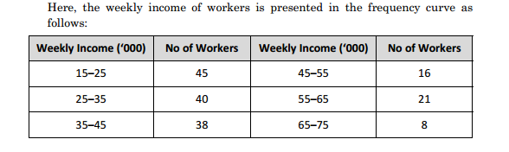
Data Preparing
3. Tabulation of data: Graphical Representation
Forms of Diagram and Chart: Types of Graphical Presentation
iii. Frequency curve: Frequency curve is another popular method of presenting data in comparable form. For this, the frequency of each class is presented along Y–axis and the class interval along X–axis. The frequency of the respective class interval is plotted just above the midpoint of the class interval, and then the points are joined with a straight line.

Slide 32
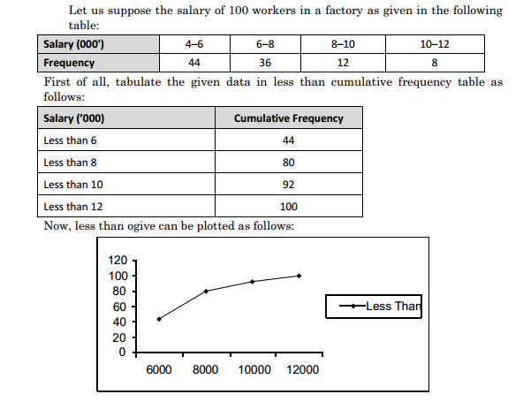
Data Preparing
3. Tabulation of data: Graphical Representation
Forms of Diagram and Chart: Types of Graphical Presentation
Ogives or Cumulative frequency curves: A curve drawn by plotting cumulative frequencies is called a cumulative frequency curve or Ogive. Before drawing, developing a cumulative frequency table is of utmost necessity. We can draw ogive in two ways:
a. The less than ogive: Less than ogive is an ogive curve in which we start with the upper limits of the classes, i.e., less than cumulative frequency, and add the frequencies.

Slide 33
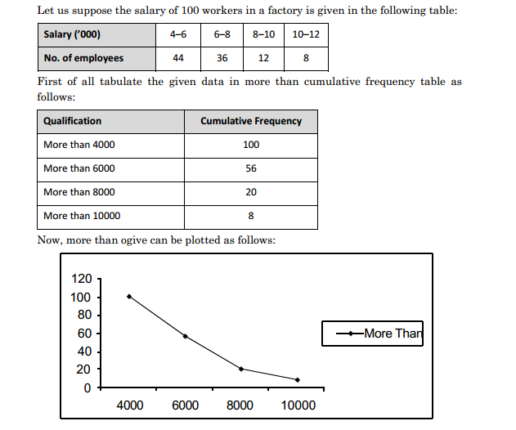
Data Preparing
3. Tabulation of data: Graphical Representation
Forms of Diagram and Chart: Types of Graphical Presentation
b. More than ogive: To plot more than ogive, first of all, we have to develop more than a cumulative frequency table from the given data. For this, we start with the lower limits of the classes, and from the frequencies, we subtract the frequency of each class and plot the cumulative frequency.

Slide 34
End of Chapter 5
(Click the arrow when in Slide Show mode)
Notes:
In Slide Show mode, click the arrow to enter the PowerPoint Getting Started Center.

